Slide 1
CNN (Convolutional Neural Network) in Machine Learning

Slide 2
1.What is CNN
A CNN (Convolutional Neural Network) is a type of deep learning algorithm mainly used to analyze images and recognize visual patterns.
It can automatically identify features such as edges, shapes, colors, textures, and objects from images.
Simple example: A CNN can learn to identify whether an image contains an apple or a banana.

Slide 3
2. CNN Architecture
The architecture describes how data passes through different layers to produce a prediction.
1. Input Layer
Receives the image as pixel values.
2. Convolutional Layer
Uses filters to extract features such as edges, colors and textures.
3. ReLU Activation
Introduces non-linearity so the model can learn complex patterns.
4. Pooling Layer
Reduces the feature-map size while retaining important information.

Slide 4
5. Flatten Layer
Converts the feature maps into a one-dimensional array.
6. Fully Connected Layer
Combines the extracted features to make a classification.
7. Output Layer
Produces the final prediction, such as Apple or Banana.

Slide 5
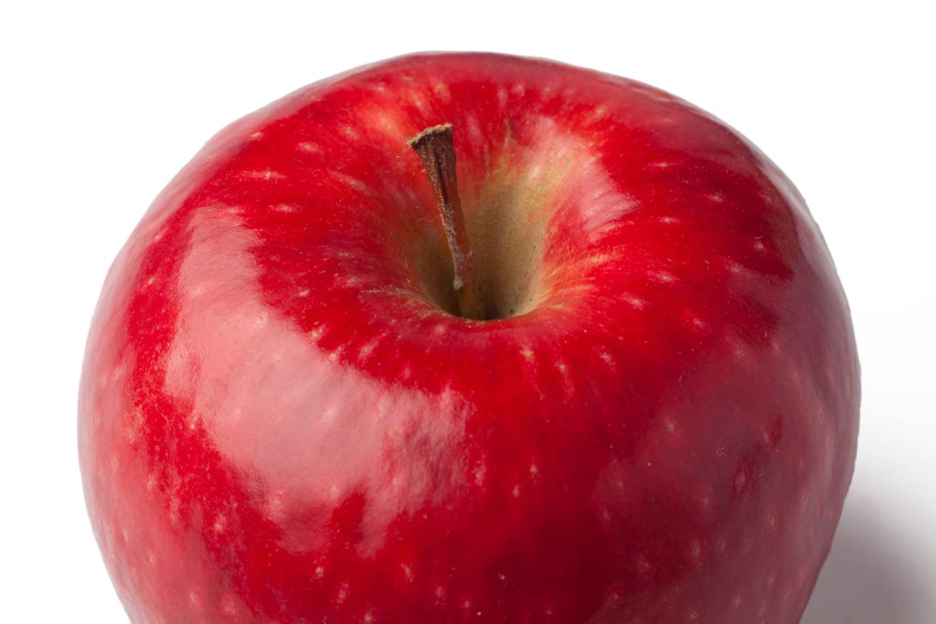
3. One real-time example: Fruit Freshness Detection 🍎
Imagine building a CNN model to classify fruits as Fresh or Rotten.
Fresh fruit

Slide 6
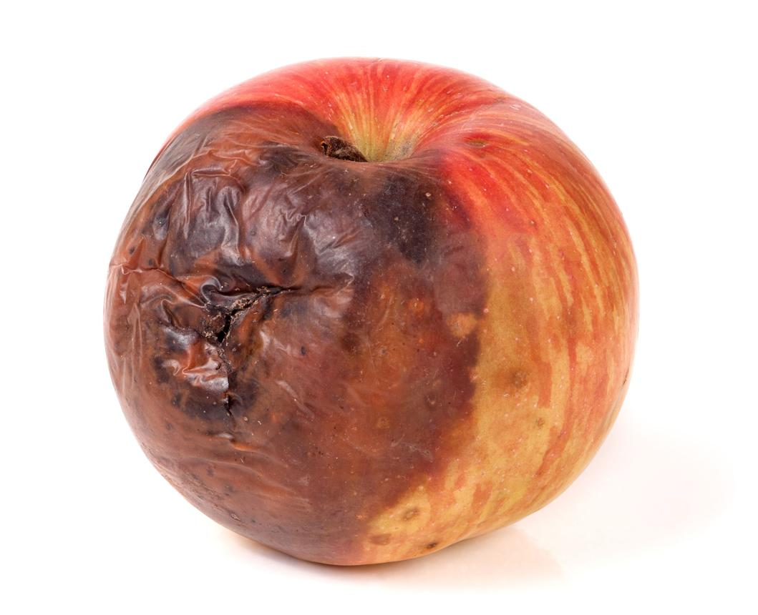
Rotten fruit
Rotten fruit
How it works:

Slide 7
How it works:
Collect images of fresh and rotten fruits.
Train the CNN using labeled images.
The convolution layers learn visual patterns such as spots, discoloration and texture.
The pooling layers reduce the feature-map dimensions.
The output layer predicts whether a new fruit image is fresh or rotten.
Result: When a new fruit image is uploaded, the model predicts its category based on the patterns learned during training.
This is useful for fruit-sorting systems, quality inspection and agricultural applications.

Slide 8
4. Advantages of CNN
Automatic feature extraction: No need to manually define every visual feature.
High accuracy: Can perform very well on image-recognition tasks when trained appropriately.
Handles complex images: Learns patterns such as shapes, textures and objects.
Parameter sharing: Reuses filters across image locations, reducing the number of parameters compared with many fully connected approaches.
Wide range of applications: Useful in healthcare imaging, facial recognition, agriculture and autonomous vehicles.

Slide 9
5. Disadvantages of CNN
Requires large datasets: Good performance often depends on having sufficient, representative training images.
High computational cost: Training complex CNNs can require powerful GPUs.
Training takes time: Large models and datasets may take a long time to train.
Risk of overfitting: The model may perform well on training images but poorly on new images.
Limited interpretability: It can be difficult to understand exactly why the model made a particular prediction.
PMC

Slide 10
Topic | Main purpose
Input layer | Receives an image
Convolution | Extracts features
ReLU | Adds non-linearity
Pooling | Reduces dimensions
Flatten | Converts features into a vector
Fully connected | Makes a classification decision
Output layer | Gives the prediction

Slide 11
Remember: CNN = Image input → Feature extraction → Feature reduction → Classification → Prediction.

Slide 12
Real-World Applications of CNN (Convolutional Neural Network):
Number Plate Recognition
Medical Image Analysis
Fruit Freshness Detection
Face Recognition
Self-Driving Cars
Defect Detection in Industries

Slide 13
THANK YOU

